Slide 1
Observability in Cloud Native Apps
July, 2019

Slide 2
Agenda
Cloud native
What is Observability
Why is it Important
Some personal experiences
How can it be done
Tools Available
Demo
Challenges
Future
Summary
Questions
LUNCH ☺
Code and presentation for this session is at
https://github.com/lruchandani/spring-boot-observability

Slide 3
About Me
Publicis Sapient (Current – Happy to be here ☺ )
Past
Infosys Technologies, India
Persistent Systems, India
Nihilent Technologies, India
14 years in Technology Consulting in multiple roles
Consulting Experience
Contractor - LD, Canada
Past
Toyota Europe, Brussels
- Visa, India
Eon, Malmo, Sweden
O2, Leeds and Liverpool ,UK
Vodafone , London ,UK
Standard Bank , Jo’burg and Capetown, SA
Passionate about
Learning , Experimentation and innovation
Software Craftsmanship (http://manifesto.softwarecraftsmanship.org/)
Cloud native app architectures
Likes
- Running , Sports (tennis ,squash, cricket – obviously ☺
- Travelling
@lruchandani
https://ca.linkedin.com/in/lruchandani

Slide 4
DISCLAIMER
NO SILVER BULLET - EVOLVING FIELD

Slide 5
Rapidly Changing times
AGILE Development
Cross-functional teams
High Pace of Innovation
Explosion of services
Higher “Always On” requirements
Waterfall Model
Disconnected teams
Slow Pace of Innovation
Less traffic
Constrained environments
Lower “Always On” requirements
2-Tier Monoliths
3-Tier Monoliths
N-Tier Monoliths
Micro-services
Serverless

Slide 6
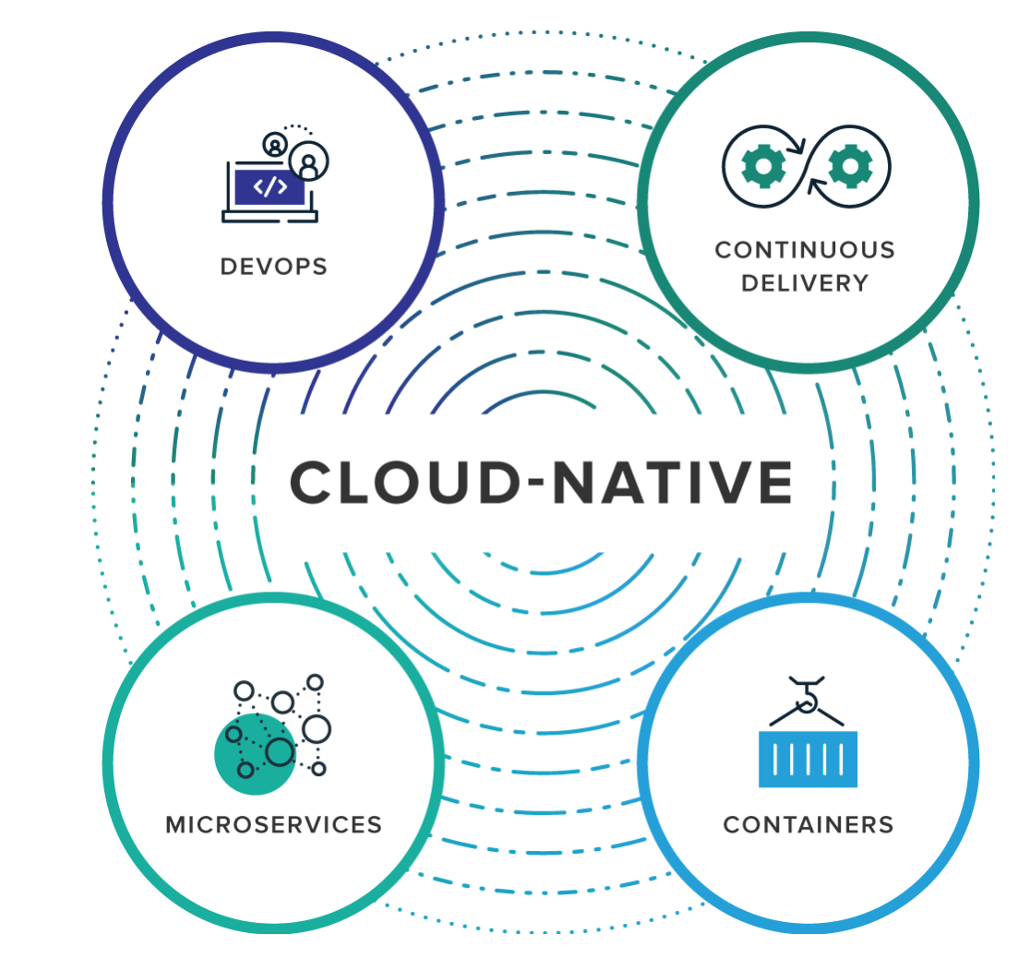
Modern application development
GOAL : Build , Ship , Scale Faster and Safer
Simplify Environments Management – Containerization
Increase business agility - Microservices*
Favor Change without compromising stability - Continuous Delivery
Enable Culture for Continuous improvement , Empower Team to innovate - DevOps

Slide 7
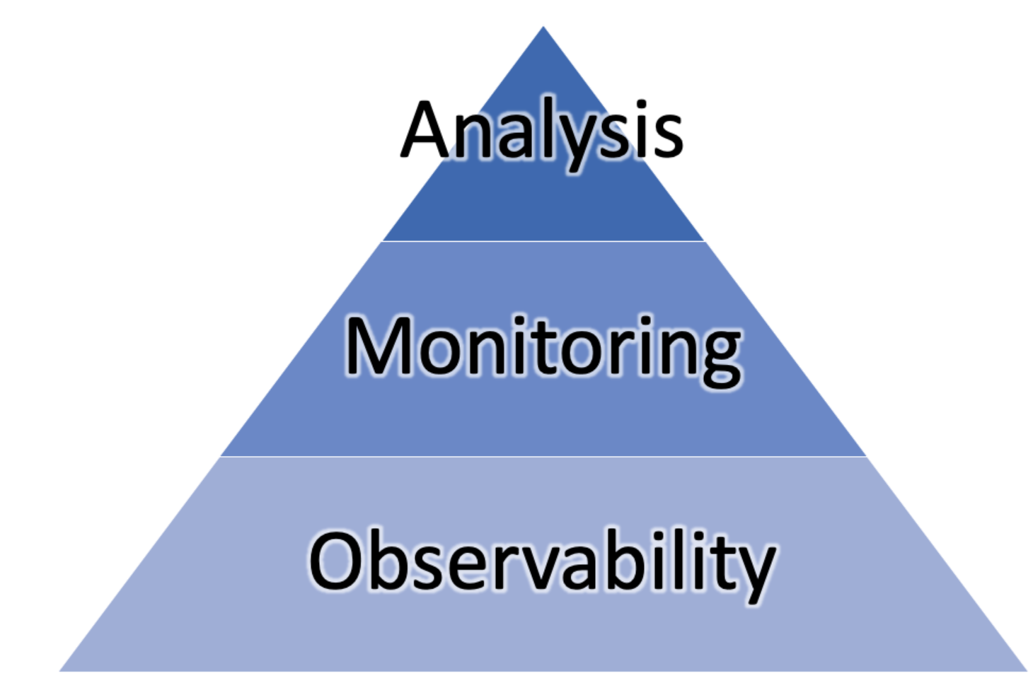
Observability - WHAT
In control theory, observability is a measure of how well internal states of a system can be inferred from knowledge of its external outputs
Simply put, it’s the care taken to enable ease in operation.
VS
Designed for observability , essential monitors , sensors helping to infer internal state
Proactive
Ask Smart question , get indicators
Hex, tcp, heap,thread – all kind of dumps
Reactive
Find answers / smoking gun !

Slide 8
Observability - why
ASPECT | OLD | NEW
APPS
CULTURE
Monolith
Microservices
NO ESCAPE
YOU BUILT IT. YOU RUN IT !!

Slide 9
Personal Experiences – WHY PRODUCTION IS FOR THE BRAVE!
telematics
TOYOTA - TELEMATICS , SERVICE AVAILABILITY AND PERFORMANCE DEGRATION AT PEEK HOURS
- What could be the reason ??
Setting on an internal httpClient “maxconnectionperhost which was default to 2” , deeply embedded
We took tcpdumps,syslogs. Etc ..focused on network, os
TOYOTA - TELEMATICS , SERVICE AVAILABILITY (ROOT CAUSE NIGHTMARE )
- Swap thrashing
EON, SWEDEN – SERVICE DEGRADATION ON PRODUCTION LAUNCH (BLACK HOLE – fireball situation)
LB was shared with many websites and was maxed out.
we ended up requesting tcpdumps and then used wireshark to analyze
50
20
subs-svc
40
cust-svc
20
20
20
20

Slide 10
Levels of observability
APP
Include All levels
Include Contextual Information
Gather understanding of monitors
Correlate information
INFRA (HW)
NETWORK

Slide 11
PILLARS OF OBSERVABILITY
Structured
Context (mdc)
Collector (fluentd)
Correlate (traceid)
Generate alerts
Generate metrics
Resource usage (threads,connection,queue depths etc)
Add Dimensions for filtering
expose percentiles
Also add business focused metrics
Add Context
Logs
Metrics
Tracing
Visualization
Cheaper
Easier to construct patterns
Sampled
Hard to trace request journey
Generalized /agg info
Cheaper
Easier to construct patterns
Sampled
easier to trace request journey
Limited Info
Monitor resource usage
Monitor percentiles
Most Rich source
Costly
Harder to construct patterns
Highest granularity

Slide 12
Instrumentation options
CUSTOM METRICS (IN CODE)
For known unknowns (connection counts, queue depths etc.)
Business focused metrics
All occurrences are reported (although aggregated)
BYTE CODE INSTRUMENTATION (AGENTS)
Code paths are sampled
For unknown unknowns
SIDE CAR PROXY (MICROSERVICES SERVICEMESH)
Less work required to enable monitoring/tracing
Provides component level traceability
Builds service graphs

Slide 13
OBSERVABILITY ARCHITECTURE
APP
collector
observability
APP
APP
collector

Slide 14
Observability tools - MICROMETER
GAUGE
A gauge is a handle to get the current value. Typical examples for gauges would be the size of a collection or map or number of threads in a running state.
COUNTER
Counters report a single metric, a count. The Counter interface allows you to increment by a fixed amount, which must be positive.
TIMER
Timers are intended for measuring short-duration latencies, and the frequency of such events. The micrometer-core modules contains a @Timed annotation that can be used by frameworks to add timing support to either specific types of methods such as those serving web request endpoints or generally to all methods.
HISTOGRAM
accumulates values to an underlying histogram and ships a predetermined set of buckets to the monitoring system., useful for percentile calculation on the server (e.g. Prometheus)
Gauge gauge = Gauge
.builder("gauge", myObj, myObj::gaugeValue)
.description("a description of what this gauge does") .tags("region", "test") // optional
.register(registry)
Counter counter = registry.counter("counter");
Counter.increment(1);
Timer.Sample sample = Timer.start(registry); sample.stop(registry.timer("my.timer", "response", response.status()));
Timer.builder("my.timer") .publishPercentiles(0.5, 0.95) // median and 95th percentile .publishPercentileHistogram() .sla(Duration.ofMillis(100)) .minimumExpectedValue(Duration.ofMillis(1)) .maximumExpectedValue(Duration.ofSeconds(10))

Slide 15
OBSERVABILITY TOOLS - tracing
Each span encapsulates the following state according to the OpenTracing specification:
An operation name
A start timestamp and finish timestamp
A set of key:value span Tags
A set of key:value span Logs
A SpanContext
http://highscalability.com/blog/2010/4/27/paper-dapper-googles-large-scale-distributed-systems-tracing.html
https://opentracing.io/docs/overview/spans/
https://cloud.spring.io/spring-cloud-sleuth/spring-cloud-sleuth.html#_span_lifecycle

Slide 16
DEMO

Slide 17
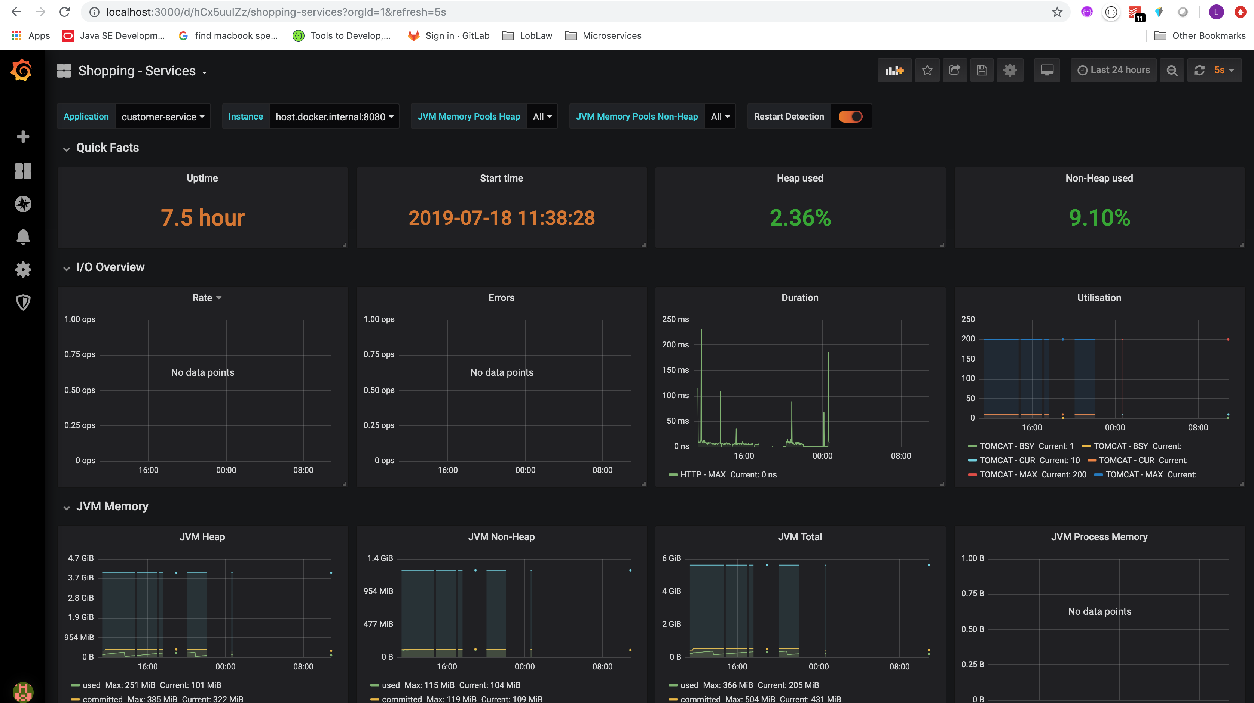
Dashboard - grafana

Slide 18
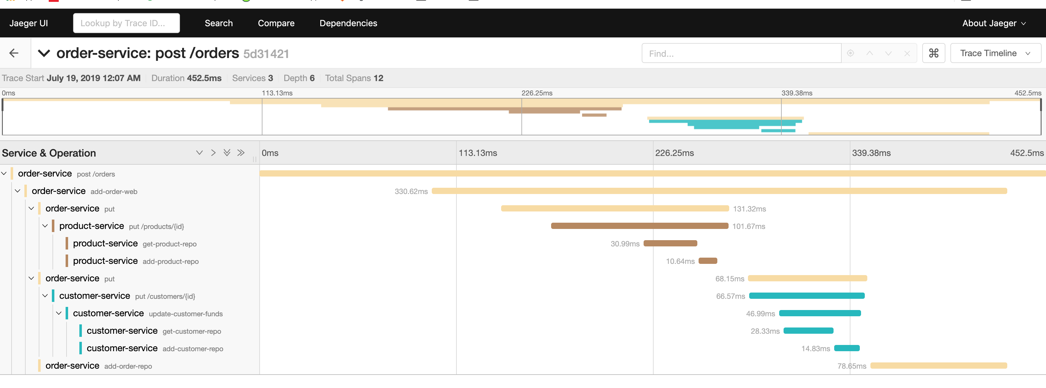
Dashboards - tracing

Slide 19
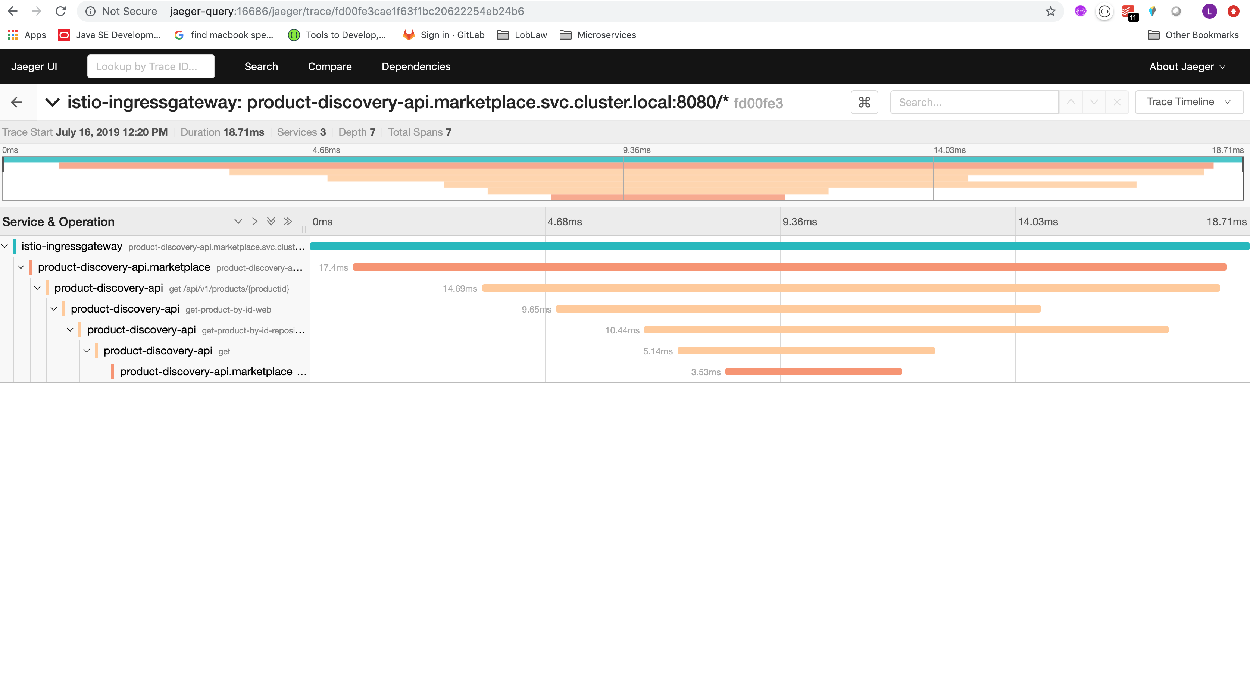
Tracing –product discovery - marketplace

Slide 20
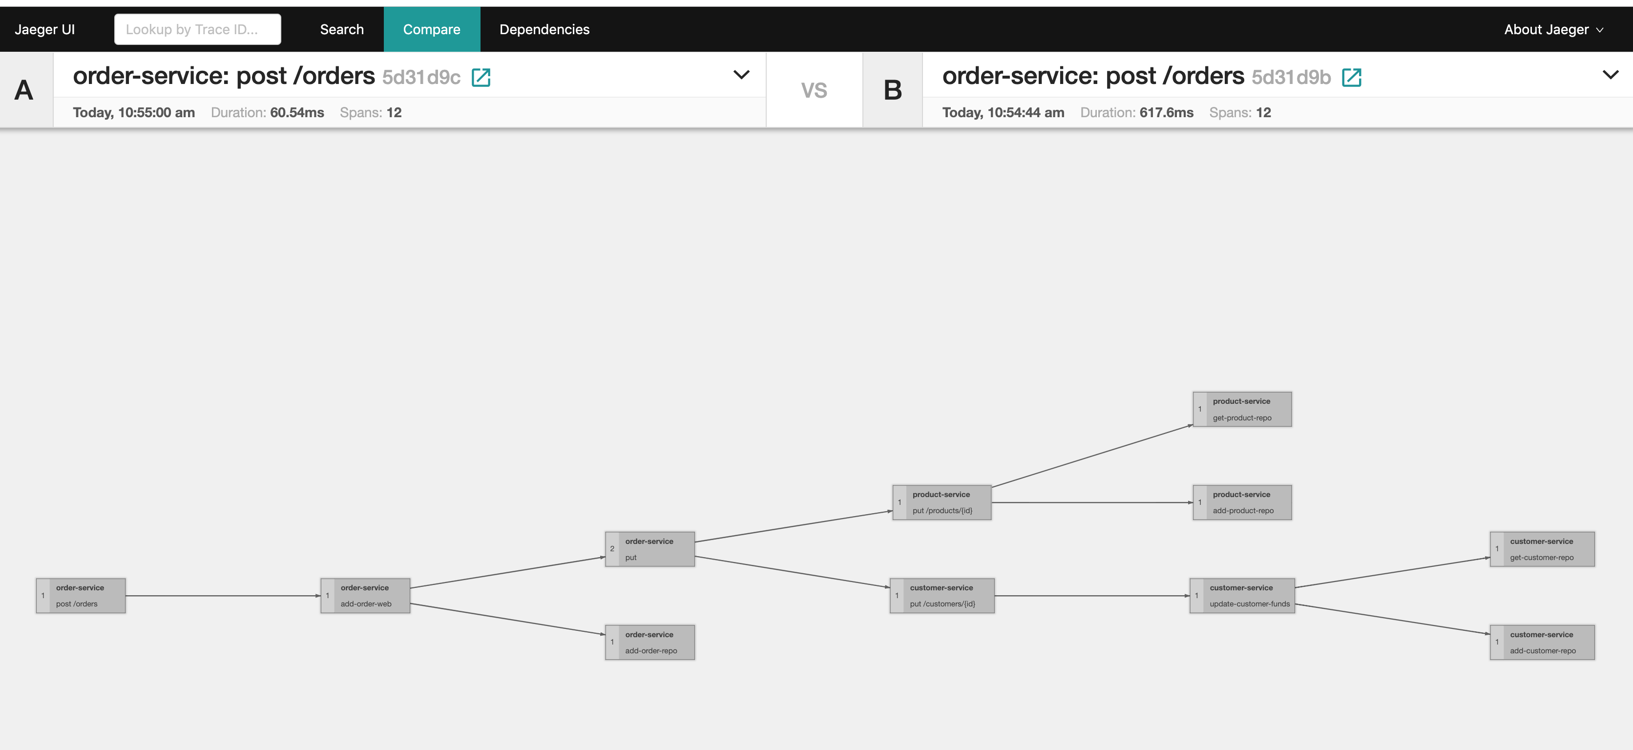
Service graph – compare traces

Slide 21
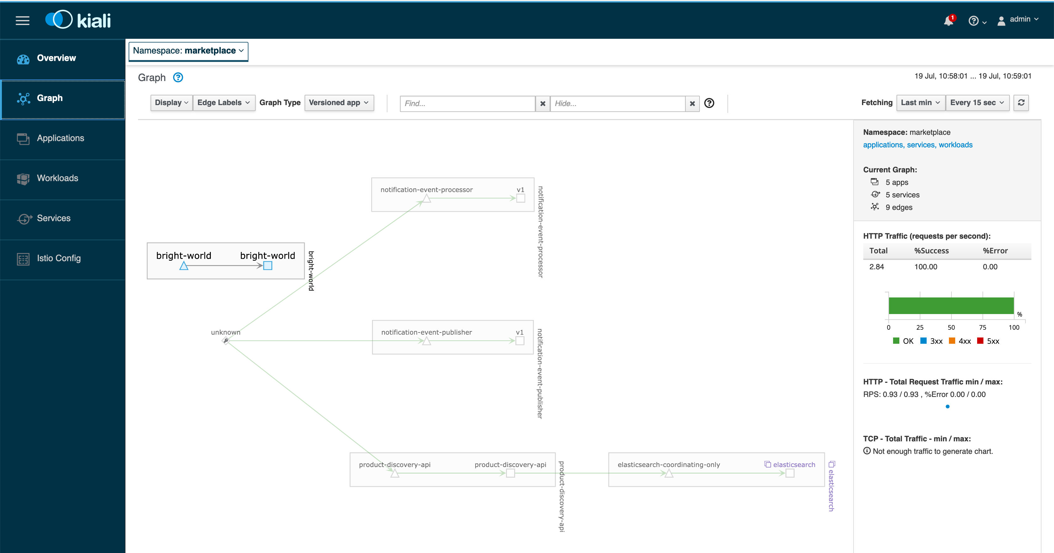
Kiali - istio

Slide 22
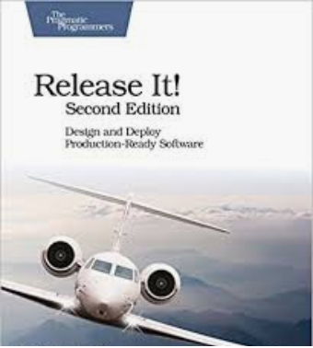
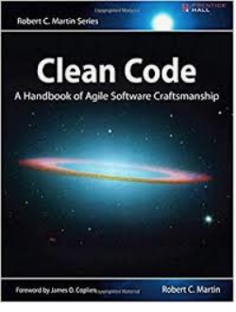
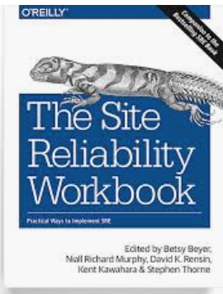
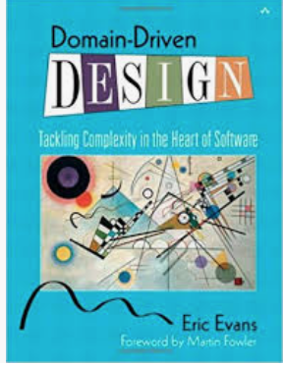
Summary
- OBSERVABILITY IS NOT A TOOL. - IT’S A CULTURE (TOOLS ARE ENABLERS)
FIND CRITICAL SUCCESS FACTORS
How many times its called
Does NFR vary based on inputs (when , how, why and by how much )
How does it participate in business transactions
SEE IF THOSE ARE ANSWERED
OBSERVABILITY DRIVEN DEVELOPMENT
ACT ON THE FEEDBACKS
ONE TOOL DOESN’T COVER ALL
PRODUCTION READY MINDSET
IN THE NOISE OF CONTAINERS, CLOUD DON’T FORGET SOFTWARE CRAFTSMANSHIP
FUTURE
- METRICS ABSTRACTION FOR EVERYTHING
- AI TOOLS TO INFER ROOT CAUSES AND TAKE REMEDIAL ACTIONS *
- EVENT DRIVEN ARCHITECTURE , EVENT SOURCING
- EVENTS AS FIRST CLASS CITIZENS IN ARCH
* Some tools do that already but there is scope for more

Slide 24
THANK YOU

